Slide 1


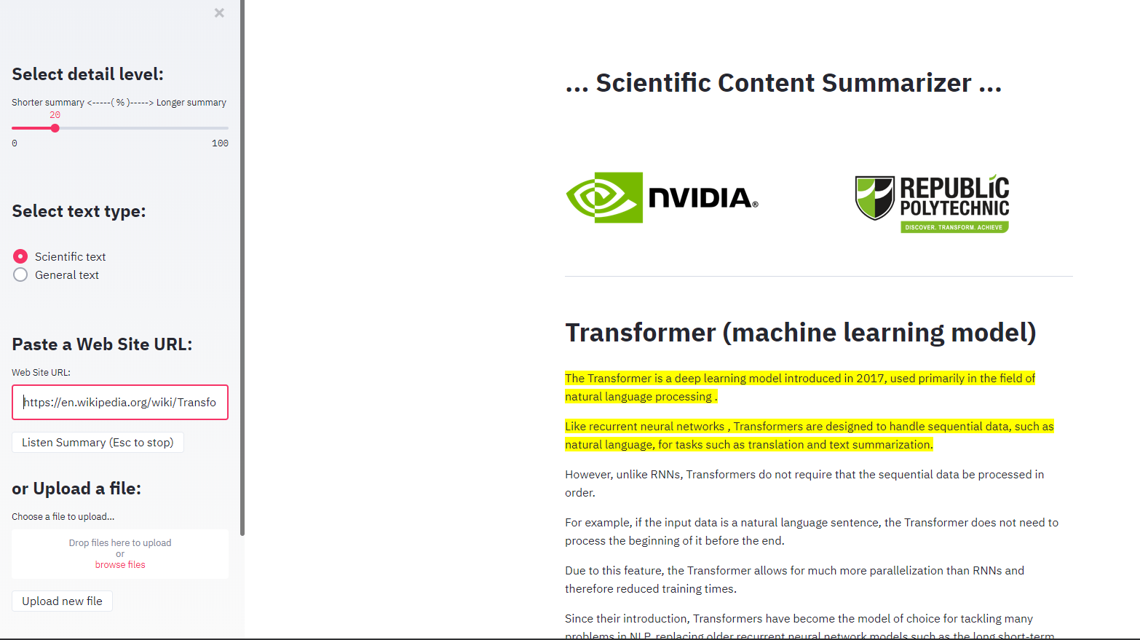
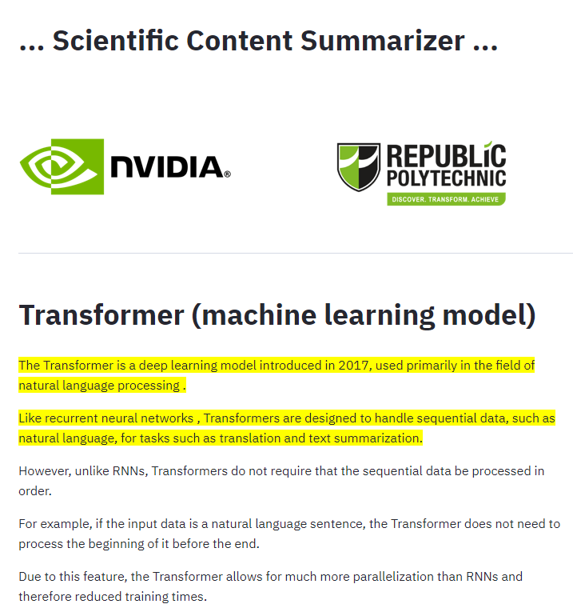

Scientific Summarizer
for Augmented Productivity
Capstone Project
Tech Immersion & Placement Programme
in Applied Artificial Intelligence
Industry Partner
Project Members
Project Mentors
Alves Martins Hugo
Ang Shandi
Timothy Liu (NVIDIA)
Tan Poh Keam (RP)
Notes:
Good morning!
Thank you for logging in so early to see our presentation.
First, we would like to thank our mentors in this project. Timothy Liu from NVIDIA,
and Tan Poh Keam, from RP, for their invaluable support in this capstone project.
Our project deals with Augmented Intelligence or how to use AI to improve the performance of humans.
In this line, for our TIPP capstone project , we developed a scientific summarizer
to help researchers when they search for relevant scientific information.

Slide 2

Project Scope
Problem
How can AI:
- harmoniously work alongside humans in support of intellective tasks?
- significantly enhance the knowledge worker’s
intellective capabilities?
- raise the knowledge worker’s productivity?
Intellective Exoskeleton (“IntelliExo”) by NVIDIA is a research concept that aims to investigate an AI Augmentation approach to enhance human intellective capabilities and alleviate – or overcome – increasing intellective workloads
Solution
Our Project
Contributes to NVIDIA Artificial Intelligence Research Assistant "AIRA" research project by creating an AI based Scientific Summarizer research assistant to work alongside the human user
The aim of the Research Assistant is to augment the academic research process, which is highly complex and non-linear, by facilitating focused attention and time savings when the user is searching for relevant content
Notes:
The project scope was proposed by the industry partner, and deals with
the fundamental problems of combining human and artificial intelligence.
Namely,
How can AI work harmoniously alongside humans in support of intellective tasks?
How can AI significantly enhance the knowledge worker’s intellective capabilities?
How can AI raise the human worker’s productivity?
The deal with these problems, NVIDIA is working on an Intellective Exoskeleton or “IntelliExo” concept.
This concept explores how AI Augmentation can enhance human intellective capabilities.
Our project contributes to this concept, by creating an AI based Scientific Summarizer assistant, to work alongside the human user.
The aim of the Research Assistant is to improve the academic research process, by facilitating focused attention
and time savings when the user is searching for relevant scientific content.

Slide 3




Objective is to create a web-based application that can summarize valuate the extractive summary by comparing with ‘Gold’ standard summary made the
Our Project
Objective is to create a web-based application that can summarize general and scientific articles
The methodology employed uses Google’s pretrained models from Hugging Face library, Sci-BERT & Distill-BERT
To evaluate the extractive summary by comparing with ‘Gold’ standard summary made by human summarizers
…Scientific Summarizer…
an AI based assistant for Augmented Productivity when performing Scientific Research
Notes:
Thanks Hugo for the introduction.,
1. Our project objective is to create a web application that summarize both generic and scientific articles.
2. Quick intro to text summarization is text summarizing are classified into 2 paradigms: extractive and abstractive.
Extractive summarization is basically to extract important representations from the original text and combing words and keyphrases into a summary.
For the more advance method, Abstractive summarization, it generate new phrases, rephrasing or using words that were not in the original text to generate summary.
Due to the difficulty of abstractive summarization, we use Extractive approach by annotation of highlighting the important words and keyphrases from the original text to create a summary.
3. As text summarization is consider a supervised machine learning problem, there are many traditional ways that we can implement such as TFIDF, Clustering,
Latent semantic analysis method, or Machine Learning approach using Naïve Bayes, Decision tree, Hidden Markov model, log-linear model just to name a few…
We settled on using RNN that is trending in the NLP field by leveraging on Google’s pretrained model BERT and their subsidiaries from a famous NLP startup HuggingFace’s library,
SciBERT for scientific summarizing task and DistillBERT for more generic summary.
And ultimately our evaluation method will be comparing the generated summary from our pretrain model with the Gold standard summary made by humans.

Slide 4






Objective is to create a web-based application that can summarize general and scientific articles
Application Design
Automatic summarization systems seek to condense the
size of a piece of text while preserving most of its important information content and meaning
INPUT
User can input URL or File in XML or TXT format
UI: Streamlit is a convenient way to create web apps for ML projects
MODEL
Implementing state-of-the-art transformer-based models
User is presented with annotated extractive summary on screen or audio format
The assistant uses state of the art NLP to produce several different levels of summarization for the articles. The summarizations can have user defined levels of verbosity
Notes:
So an overview of our application design.
We use streamlit to design the frontend web application for user to input 3 types of text, URL, XML formatted file or TXT files.
We also use streamlit to host the backend summarization engine.
The summary engine is run by implementing SOTA model, sciBERT and distillBERT.
The inputs will pass through the engine and generate a highlighted summary base on the original corpus
And the generated summary will be displayed on screen and by audio format.

Slide 5

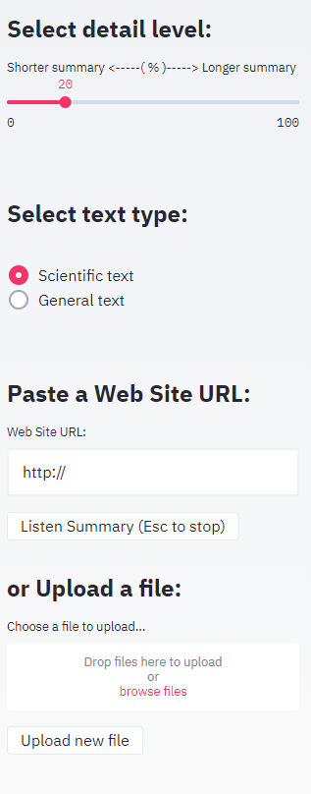
Application Design
Summarization detail
The assistant uses state of the art NLP to produce user defined levels of summarization for the contents, offering different levels of verbosity
The assistant allows for the user to chose the summarization engine most suitable to the type of content being summarized
Type of content (Scientific and General)
Content Input
URL uploader - works best with simple websites heavy in text (e.g. Wikipedia or Scientific papers from PlosOne)
File-uploader (*.txt and *.xml)
Content Output
On Screen, showing the full content with the summarized sentences highlighted
Listen to the summary with the embedded speech synthesizer
Notes:
So an overview of our application design.
We use streamlit to design the frontend web application for user to input 3 types of text, URL, XML formatted file or TXT files.
We also use streamlit to host the backend summarization engine.
The summary engine is run by implementing SOTA model, sciBERT and distillBERT.
The inputs will pass through the engine and generate a highlighted summary base on the original corpus displayed on screen and by audio format.
####
Automatic summarization systems seek to condense the
size of a piece of text while preserving most of its important information content and meaning
The assistant uses state of the art NLP to produce several different levels of summarization for the articles. The summarizations can have user defined levels of verbosity

Slide 6
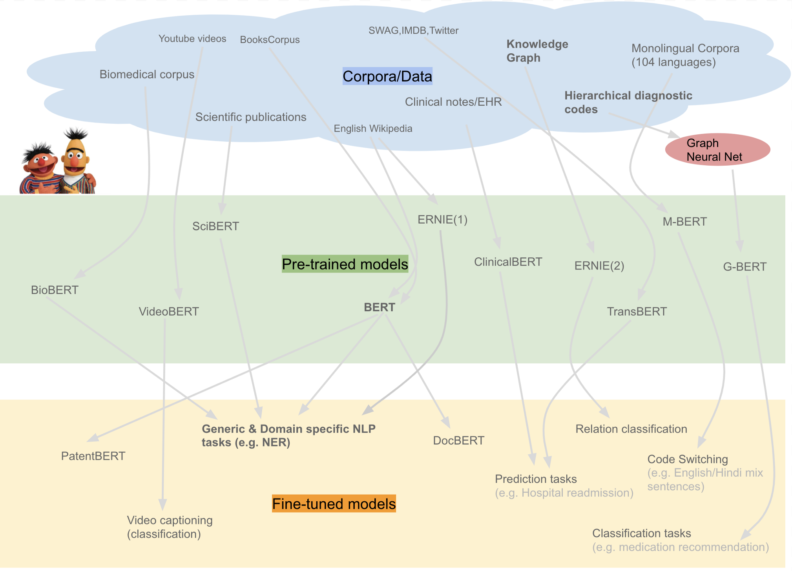
Pre-Trained models
Bidirectional Encoder Representations from Transformers (BERT)
Credit: Ajit Rajasekharan
Bidirectional Encoder Representations from Transformers (BERT) is a technique for NLP (Natural Language Processing) pre-training developed by Google in 2018.
It uses bidirectional self-attention, often referred to as a "transformer encoder".
The original BERT was pre-trained with a dataset consisting of 11,038 unpublished books from 16 different genres and 2,500 million words from text passages of Wikipedia.
Notes:
BERT or Bidirectional Encoder Representations from Transformers is a technique for Natural Language Processing using pre-trained models developed by Google.
The original BERT was pre-trained with a dataset of unpublished books and 2,5 million words from text passages of Wikipedia.
Pre trained Transformer based models can be used standalone or as the base layer for fine-tuned models. In our project we used the standalone models without a final fine-tuning step.
As the Summarization Engines, we used the Hugging face transformers library and chose two BERT based contextual embedding models. Scibert and Distilbert .
###############################################################################################################
Utilizing the BERT language model, our summarizer computes a contextual representation, i.e. an n-dimensional vector, for every sentence.
The summarizer uses the contextualized embeddings to quantify the informative content of sentences and assess the similarity between them.
The idea is that those sentences with similar scores share similar context.
Subsequently, the summarizer selects the most informative sentences to generate the final summary.

Slide 7

Pre-Trained models
Scientific content:
SciBERT scivocab uncased
Released in 2019, the pre-trained feature extractors leverage a large multidomain scientific corpus with a total of 3.17 billion tokens
Trained with a Semantic Scholar dataset consisting of 1.14 million scientific publications with 18% of the papers from computer science domain and 82% from the broad biomedical domain
General content:
DistilBERT base uncased
DistilBERT is a small, fast, cheap and light Transformer model trained by distilling the Bert base. It has 40% less parameters than bert-base-uncased, runs 60% faster while preserving over 95% of Bert’s performances as measured on the GLUE language understanding benchmark
Notes:
As pre trained models, for Scientific content, we use Scibert.
Scibert is a BERT based model but pre-trained in a large multidomain scientific corpus from the Semantic Scholar dataset consisting of 1.14 million scientific publications from computer science and biomedical research.
For more General content, we use Distilbert.
DistilBERT is a smaller and faster version of BERT trained by distilling the Bert base. It has 40% less parameters, runs 60% faster while preserving over 95% of Bert’s performances
This distinction between scientific and general type of content is important because the researcher often needs to alternate between scientific articles and other sources of information, such as news, company info, or Wikipedia for instance.
Giving the choice to alternate between the two summarizer engines improves the functionality and usability of the app for the researcher.

Slide 8
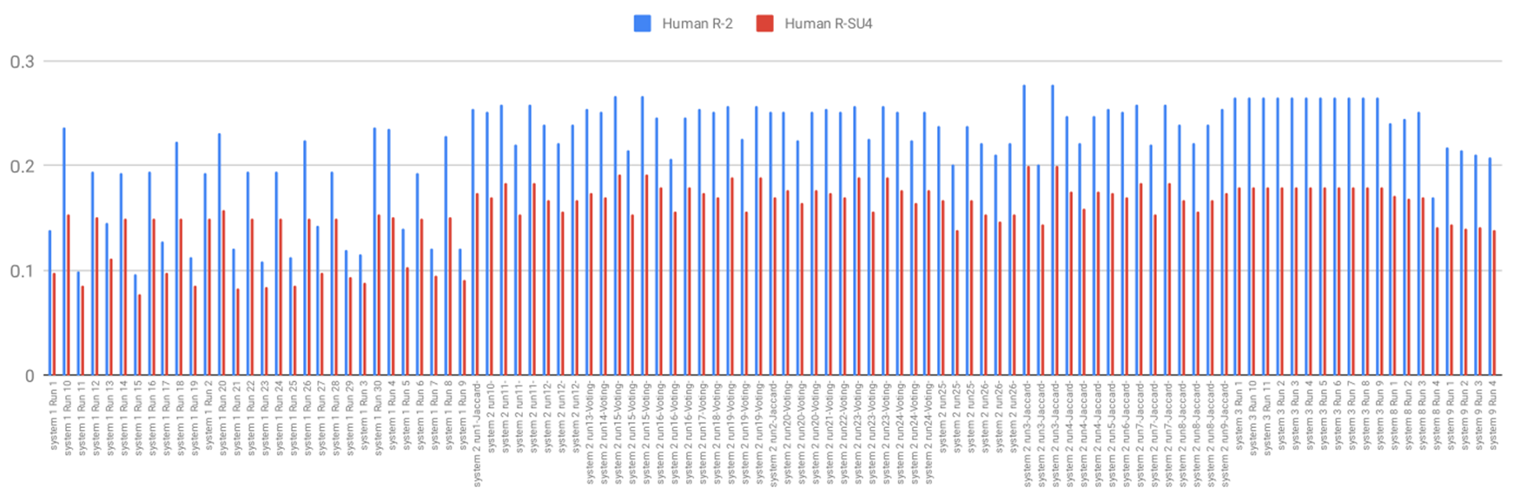
Quality of Results
ROUGE-2 & ROUGE-SU4 results for all the models presented at SciSumm 2019
ROUGE is a set of metrics used to automatically evaluate summarization systems
Measures the overlap between computer-generated summaries and human written reference summaries (Lin, 2004)
ROUGE-2 measures the bigram overlap between the candidate computer-generated summary and the reference summaries.
ROUGE-SU4 uses bigrams with a maximum skip distance of 4 between bigrams
Scientific Summarizer
Notes:
Transformer models are the state of the art in NLP, so the performance is very high, even when using the base models without fine tuning.
We measured the performance of our two summarization engines in a dataset used in the SciSumm competition.
The dataset has one thousand scientific articles and their corresponding human made summary.
The competition held every year, measures how well the competing models can produce summaries that match the human made summaries
As you can see in the results for 2019, the rouge scores for our models using the fall in the middle range of the results
Also, because the dataset is made of scientific articles, the results for the Scibert summaries are a little better than for distilbert summaries
Now let’s see the app in action

Slide 9
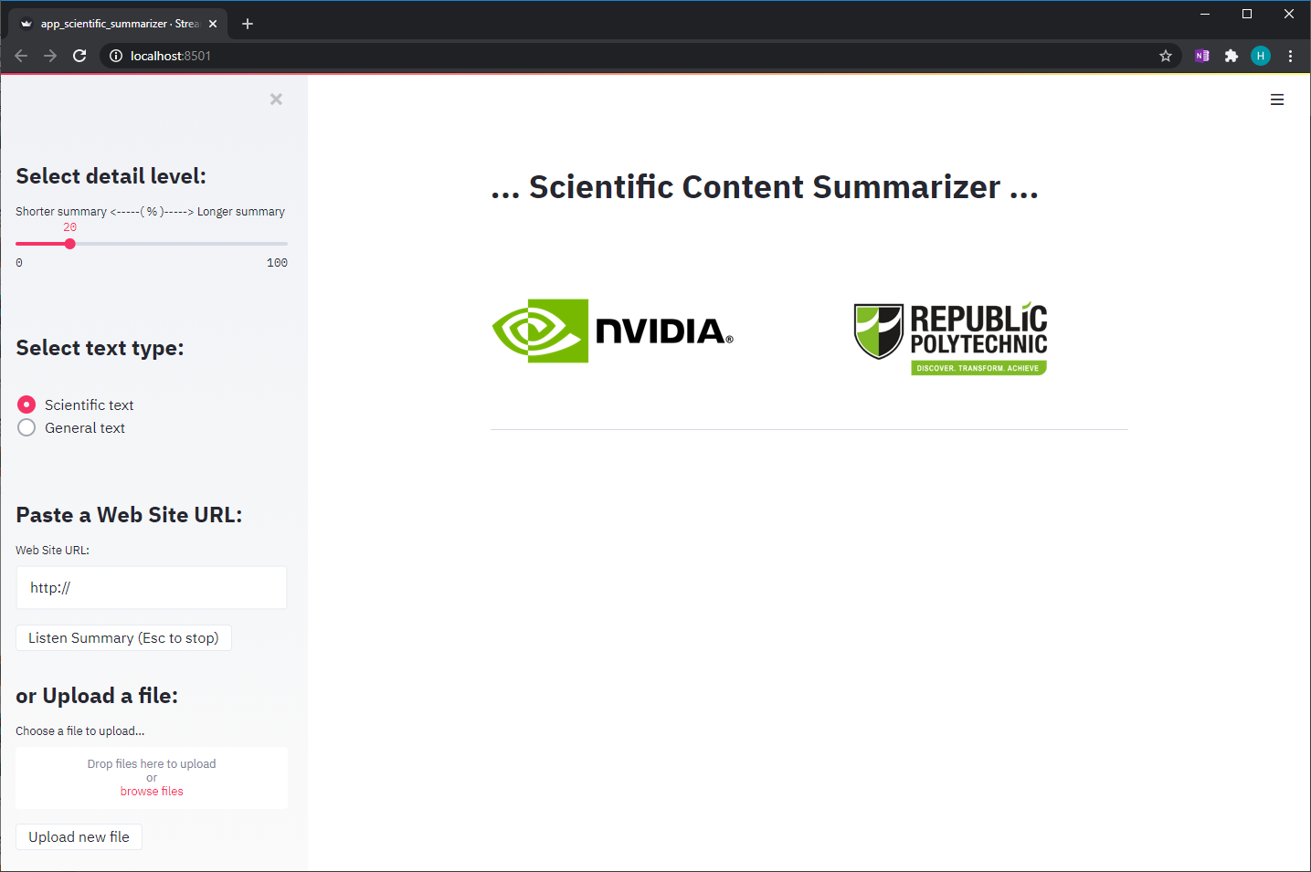
Live Demo

Slide 10
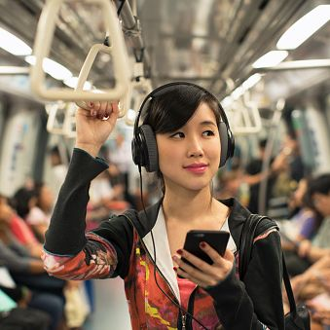
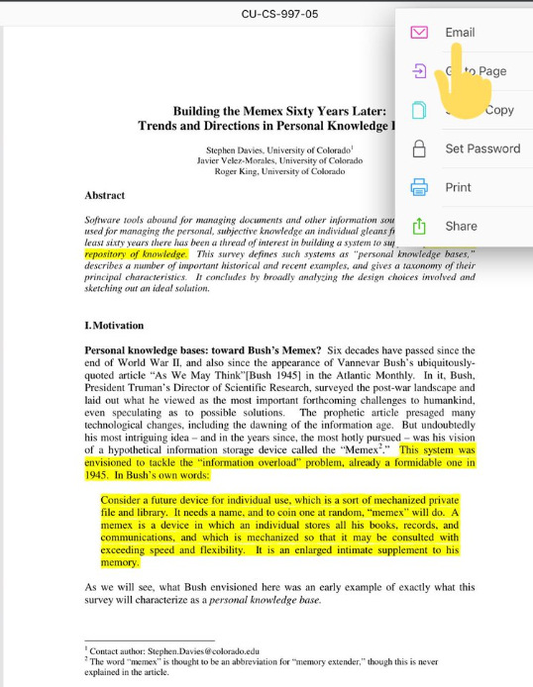
Future improvements
Research Assistant Mobile
Mobile version with enhanced Audio features to allow for the user to listen summaries of research papers while commuting.
- Cloud storage of Audio files of summarization
results
- User interface to allow easy identification and manipulation of files
Easy sharing with other researchers
Options to share summarized content via Email or messaging apps
User feedback on the quality of summaries
This information can be used to future model fine tuning, according to the user preferences regarding content summaries
Notes:
So an overview of our project is we have produced a summarizer by leveraging on pretrained SOTA transformer-based model, sciBERT and distilBERT.
and evaluating the results by using benchmark datasets from SciSumm and getting middle range results.
Some possible future improvements that we recommend is to
Implement feedback feature to capture the user comments on the quality of summary, this information can then be used to fine tune the model.
Another feature can be to create an Easy sharing function tat allow sharing to other people through different channels like email or messaging apps.
And finally the deployment on other platforms like mobile app version with enhanced audio features to allow commuters to listen the summaries.
And with that we will end our presentation, Thank you.

Slide 11
Thank You

